Slide 1

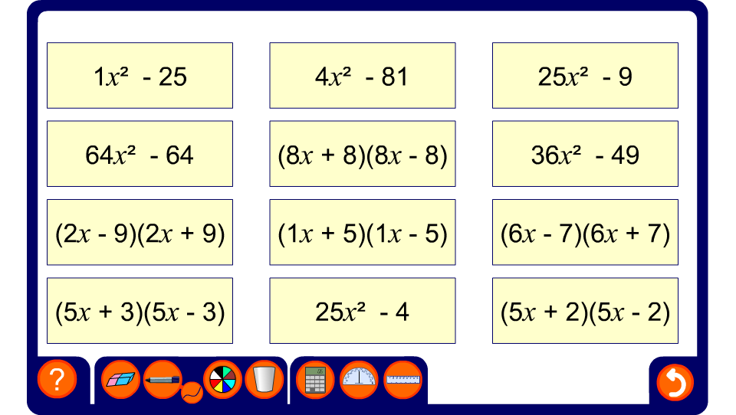


Matching the difference between two squares
Notes:
Select a bracketed expression and ask a volunteer to find its corresponding expansion.

